Slide 1
A Framework for Formal Verification of Behavior Trees With Linear Temporal Logic
Oliver Biggar
Mohammad
Zamani
IEEE ROBOTICS AND AUTOMATION LETTERS(RA-L)

Slide 2
IDEA
There does not currently exist a method to formally verify BTs correctness without compromising their most valuable traits: modularity, flexibility and reusability.
Reusability：atomic actions and subtrees present a common interface, so “individual behaviors can be reused in the context of a higher-level behavior”
Flexibility：Changes in one part of the system [do] not affect other parts
Modularity：“the designer [of one sub-behavior] does not need to know which sub-behavior will be performed next”

Slide 3


CONTRIBUTIONS
The main contribution of this paper is a new framework and method for verification of BTs that allows correctness to be checked without violating the three principles above.
a new mathematical framework
BT
LTL

Slide 4
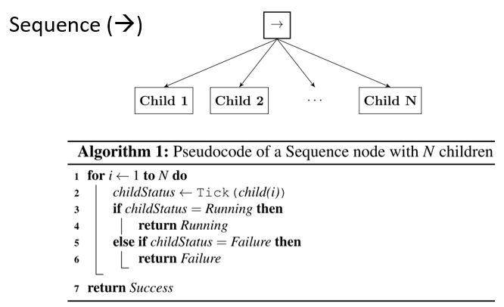
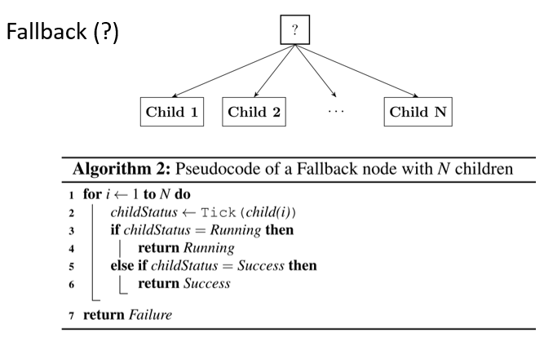
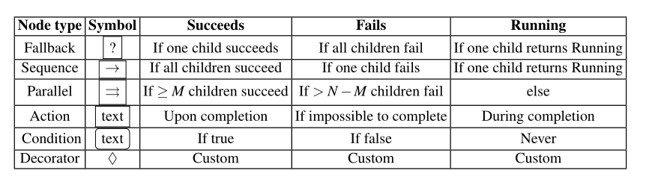
Behavior Tree

Slide 5



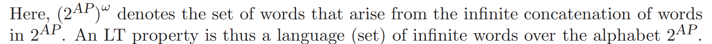
Linear Temporal Logic
Linear Temporal Logic (LTL) is an extension of propositional logic which includes qualifiers over linear paths in time.
Given a set AP of atomic propositions, the syntax of LTL is given by the following grammar
An LTL formula is satisfied by a sequence of truth assignments over AP , which can be considered an ω-word over the alphabet given by 2^{AP} [(2^{AP}) ^{ω}].

Slide 6
Linear Temporal Logic
Linear Temporal Logic (LTL) is an extension of propositional logic which includes qualifiers over linear paths in time.
Given a set AP of atomic propositions, the syntax of LTL is given by the following grammar
An LTL formula is satisfied by a sequence of truth assignments over AP , which can be considered an ω-word over the alphabet given by 2^{AP} [(2^{AP}) ^{ω}].
If φ is an LTL formula, L(φ) is the ω-regular language containing all ω-words that satisfy φ. If φ and ψ are LTL formulas, then φ |=ψ if L(φ)⊆ L(ψ) and we say φ entails ψ. This means in any sequence where φ holds , ψ also holds.

Slide 7
Framework
They generalize execution nodes and subtrees into a single mathematical object we call a behavior, and describe control flow nodes as operators over behaviors. Then describe the execution of behaviors by LTL formulas.
Assumption 4.1：The ticking of the classical tree is effectively instantaneous. In other words, the environment doesn’t change between when we tick the root and when we tick any child node.
Assumption 4.2：Assume any subtree returns exactly one value every time it is ticked.

Slide 8
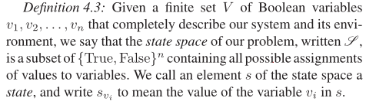
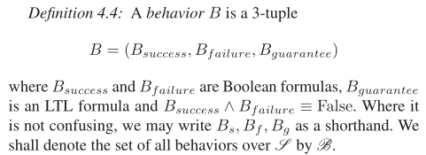
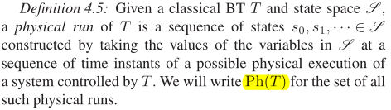
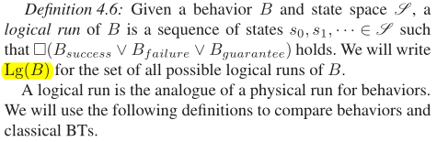
Framework
State space
Behavior
physical run
Logical run

Slide 9
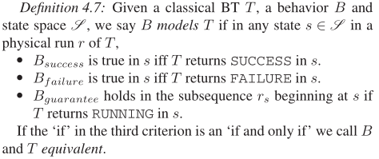
Framework
B models T
Condition：a behavior where C_{success}∨C_{failure} is a tautology
Negation：Given a behavior B, ∼ B =(B_{failure}, B_{success}, B_{guarantee})
Sequence：If A and B are behaviors then
(A→B)_{success} = A_{success}∧ B_{success}
(A→B)_{failure} = A_{failure}∨ (A_{success}∧ B_{failure})
(A→B)_{g} = (¬A_{f}∧ ¬A_{s}∧ A_{g})∨ (A_{s}∧ ¬B_{f}∧ ¬B_{s}∧ B_{g})
Fallback：If A and B are behaviors then A?B =∼(∼ A→∼ B)

Slide 10
Framework
Parallel Sequence：If A and B are behaviors
(A⇒B) _{success} = A_{success}∧ B_{success}
(A⇒B) _{failure}= A_{failure}∨ B_{failure}
(A⇒B)_{g} = (¬A_{s}∧ B_{s}∧ A_{g})∨ (A_{s}∧ ¬B_{s}∧ B_{g})∨ (¬A_{s}∧ ¬B_{s}∧ A_{g}∧ B_{g})
Parallel Fallback：A??B =∼(∼ A⇒∼ B)
Others：
∼∼ A = A
∼(A→B) =∼ A?∼ B
∼(C⇒D) =∼ C??∼ D
Lemma：Suppose S is a classical BT, with a Sequence node as the root, and L and R its two children. Suppose now we have behaviors B_{L} and B_{R} that model L and R respectively. Then B_{L}→B_{R} models S. This Lemma also holds for Fallback nodes.
Theorem：Suppose we have a set A of Action and Condition nodes, and a set B of behaviors where each b∈ B has an a∈ A which it models. Let T be a classical BT over A. Let R be the behavior obtained by composing B in the structure given by T . Then R models T .

Slide 11

VEIFICATION
Problem：Given a classical BT T composed of Action and Condition nodes T₁, . . . , T_{n} and an LTL formula ϕ representing the system specification, verify that all physical runs of T satisfy ϕ.
Solution： Construct a formula that is true in all physical runs of the BT, and check if this formula entails the specification formula.
Behavior
（models BT by LTL）
BT
LTL

Slide 12

VEIFICATION
Step1：Ph(T )⊆ Lg(B))
Step2：Lg(B)⊆ L(ϕ) / □(B_{success}∨ B_{failure}∨ B_{guarantee}) |=ϕ
Result：Ph(T )⊆ Lg(B)⊆ L(ϕ)
Proof： Suppose for contradiction that r∈ Ph(T ) \ Lg(B).Then □(B_{s}∨ B_{f}∨ B_{g}) does not hold in r, so ∃i∈ N such that B_{s}∨ B_{f}∨ B_{g} does not hold in the subsequence starting at r_{i}. As r is a physical run, at each instant r_{i} T has a return value (Assumption 4.2). B models T , so if T returns SUCCESS then B_{s} holds; if T returns FAILURE then B_{f} holds, and if T returns RUNNING then B_{g} holds in the subsequence beginning in r_{i}. Then B_{s}∨ B_{f}∨ B_{g} holds in the subsequence beginning in r_{i}, which is a contradiction.

Slide 13
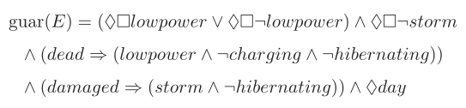
Add Environment
Problem： Given classical BTs T and E in a common state space S and an LTL specification ϕ, verify that all physical runs of the combined system satisfy ϕ.
Step1： Ph(T) ∩ Ph (E) ⊆ Lg(T_{B})∩ Lg(E_{B})
Step2： Lg(T_{B}) ∩ Lg(E_{B})⊆ L(ϕ)

Slide 14
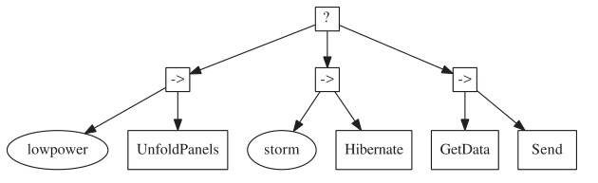
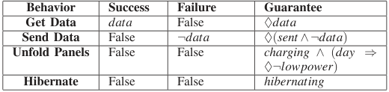
EXAMPLE

Slide 15
EXAMPLE
B_{s} = lowpower ∧ False = False
B_{f} = ¬lowpower ∨ (lowpower ∧ False) = ¬lowpower
B_{g} = (¬lowpower ∧ lowpower ∧ True) ∨ (lowpower ∧ True ∧ charging ∧ (day⇒♦¬lowpower))
= lowpower ∧ charging ∧ (day⇒♦¬lowpower).

Slide 16
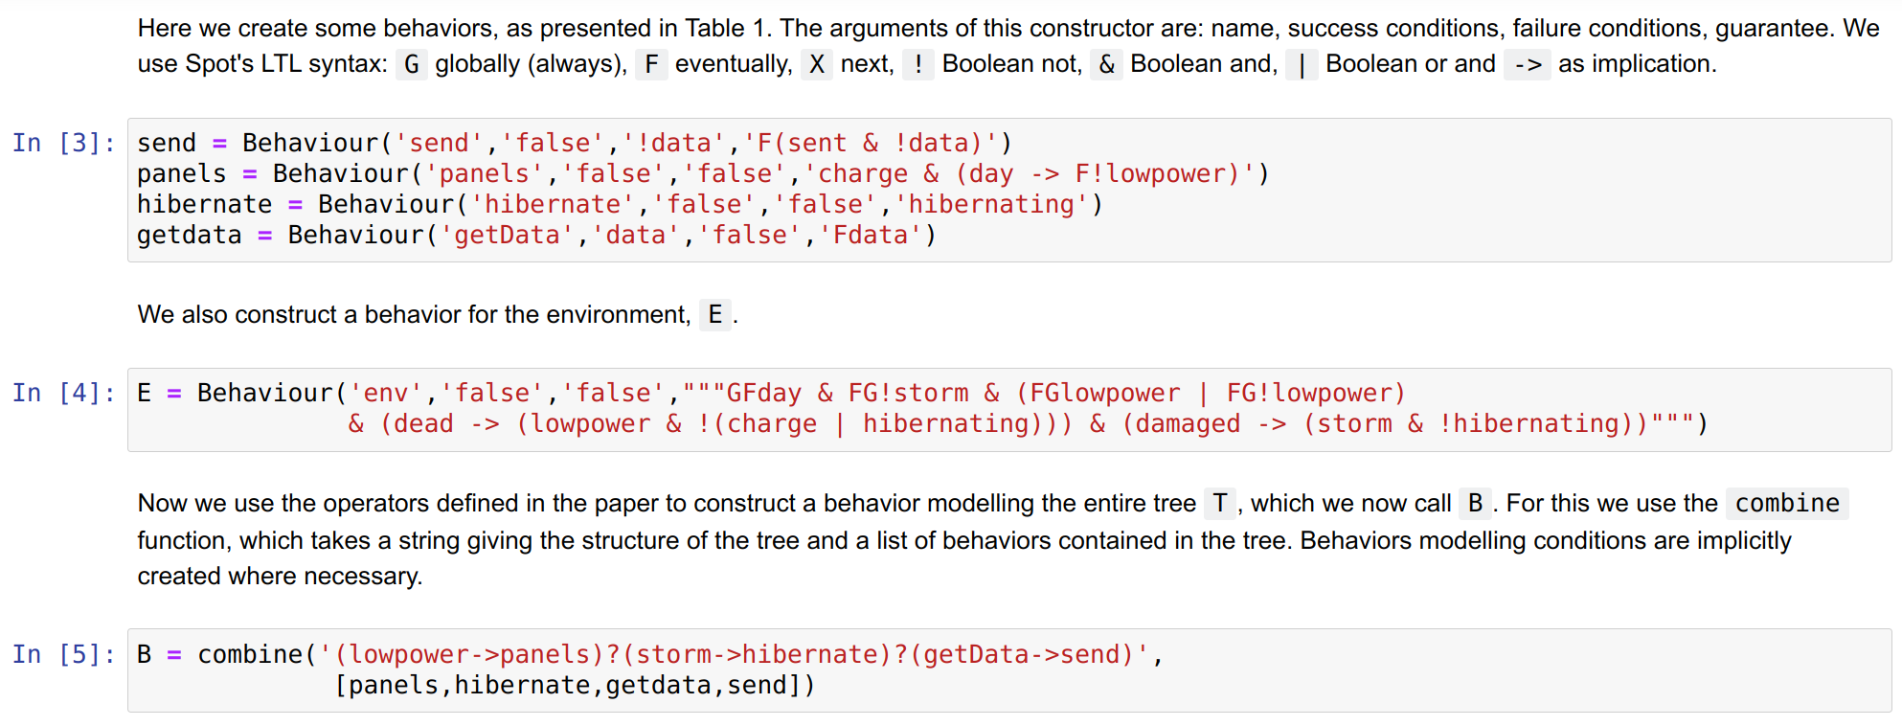
IMPLEMENTATION

Slide 17
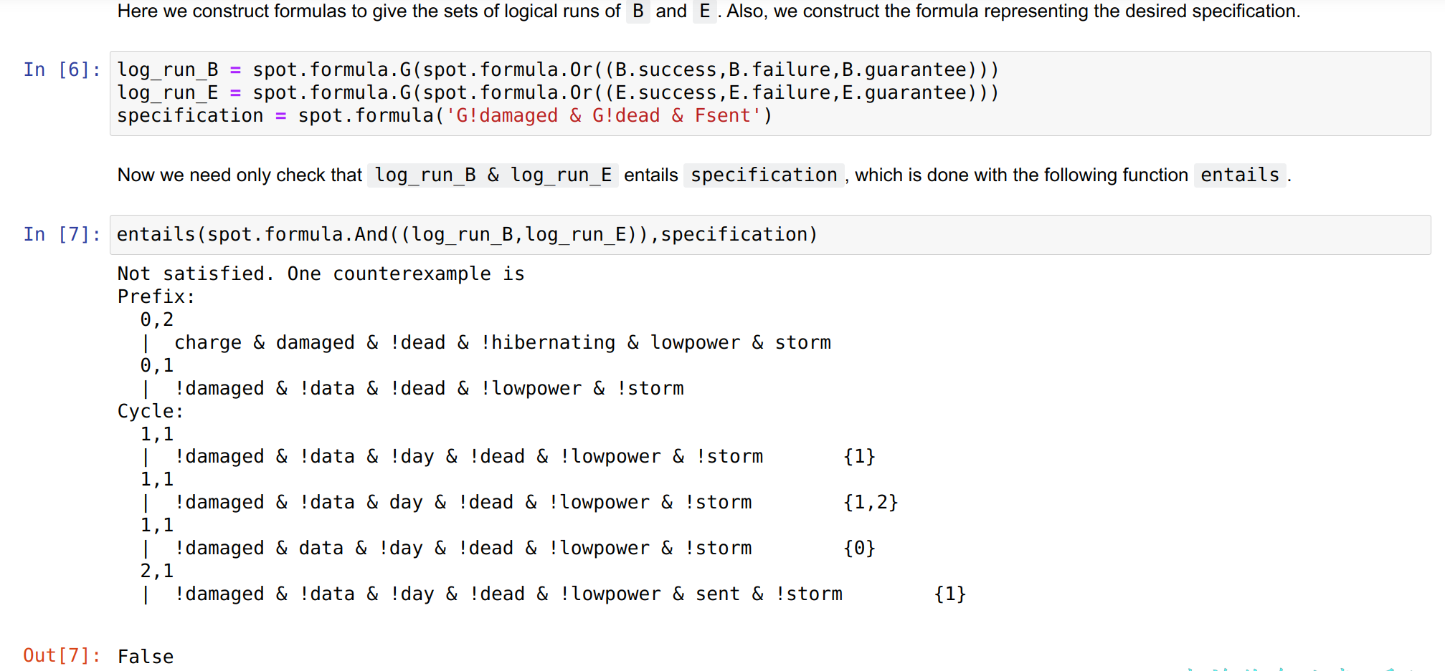
IMPLEMENTATION

Slide 18
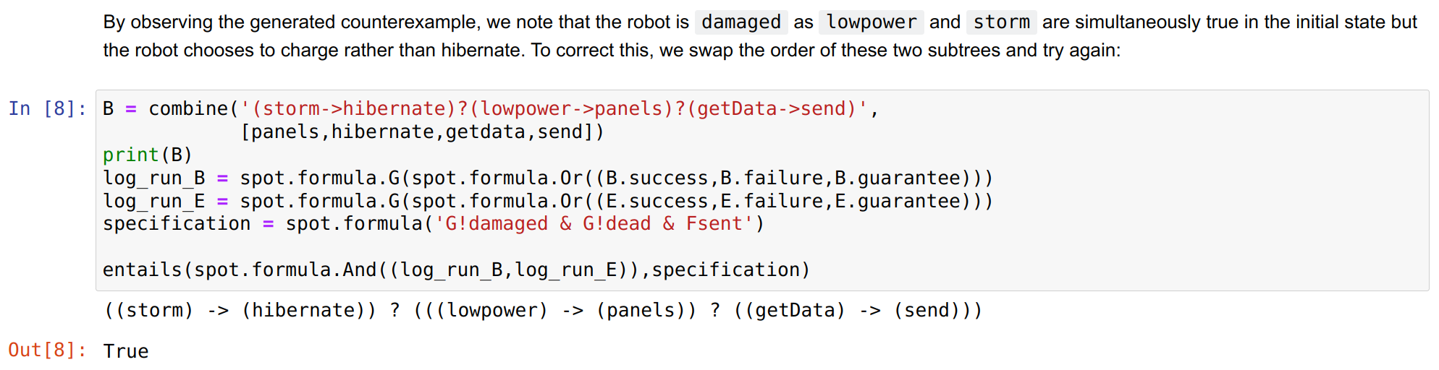
IMPLEMENTATION

Slide 19
THANK YOU

